Slide 1
7.3.4 HTTP – The HyperText Transfer Protocol
- Specifies what message clients may send to servers and what responses they get back in return
Each interaction consists of one ASCII request, followed by one RFC 822 MIME-like response
Protocol defined in RFC 2616
Connections: a TCP connection to port 80; no worry about lost messages, duplicate messages, long messages
Methods: each request consists of one or more lines of ASCII text, with the first word on the first line being the name of the method requested [see fig 7-41]
Every request gets a response consisting of a status line and possibly additional information [see fig 7-42]

Slide 2
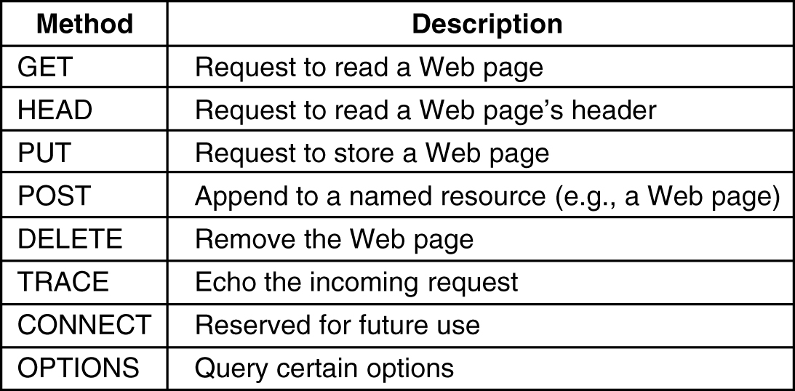
Figure 7-41. The built-in HTTP request methods.

Slide 3
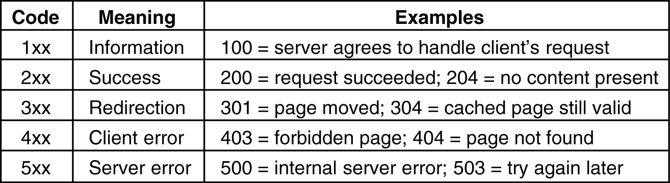
Figure 7-42. The status code response groups
Message Headers: additional lines with more information follow the request line or response line.[see fig 7-43]
Example HTTP Usage [see fig 7-44]
    telnet www.ietf.org 80 >log
    GET /rfc.html HTTP/1.1
    Host: www.ietf.org
    close

Slide 4
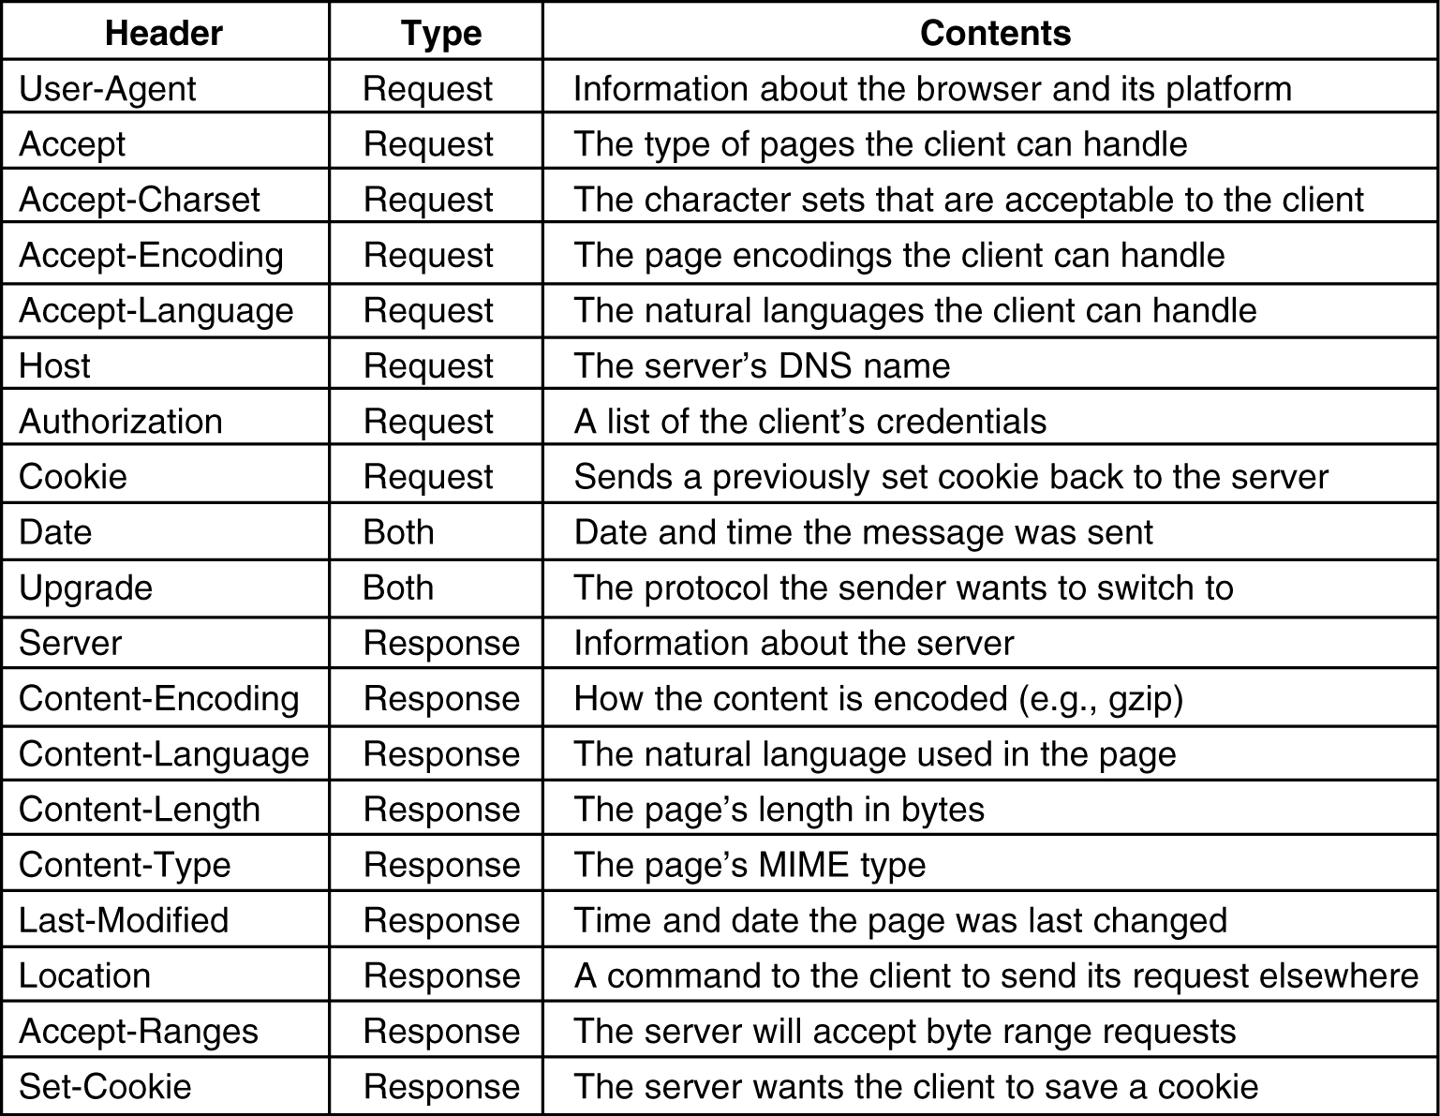
Figure 7-43. Some HTTP message headers.

Slide 5
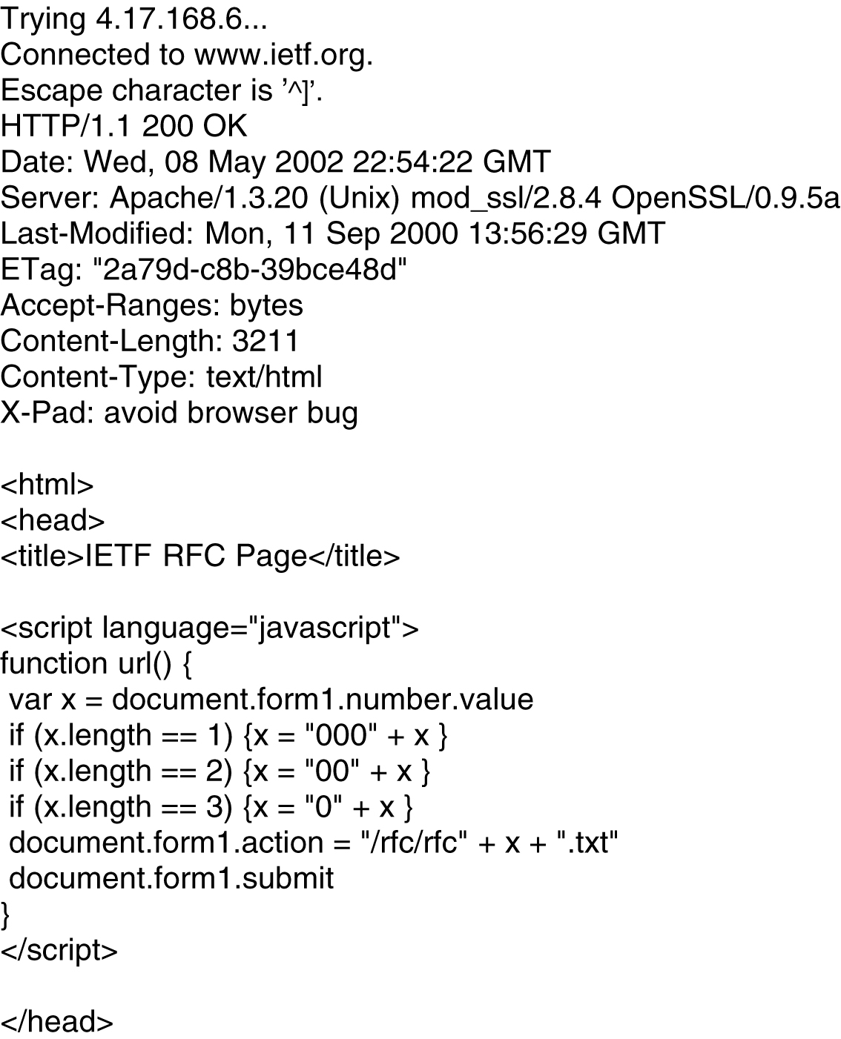
Figure 7-44. The start of the output of www.ietf.org/rfc.html

